Slide 1
Challenges in the adoption of used EVs

Slide 2
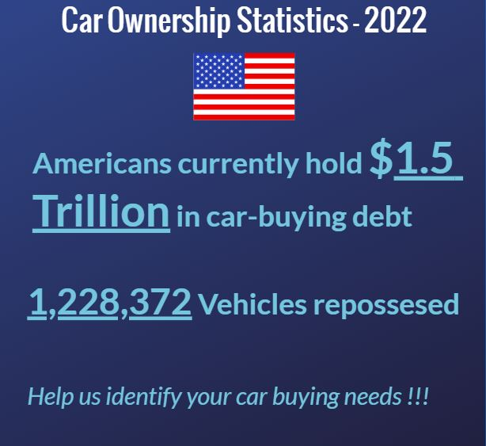
Previous Approach – Max Diff survey via FB Ads
The survey was only fielded to individuals in geographical regions identified as Disadvantaged based on the dataset from the Energy Justice Dashboard.

Slide 3
Max Diff survey via FB Ads (continued)
Results:
Total funds spent on Facebook ads - $1203.49
The total number of impressions (the number of times the ad was shown on screen) - 825,530
Reach (Number of unique accounts who saw the ads) - 330,854
The number of times the survey link was clicked - 3299
Number of respondents who completed the survey - 107
Average cost per complete - $11.37
Respondents with reported income below $75,000 - 41

Slide 4
Current Approach: Choice-based Conjoint Surveys (will be fielded in Qualtrics)
Survey focused on used EV vehicle market.
Users decide their budget and they are shown vehicles that are within the range of their budget (80% - 110%)

